Slide 1
Comp 2021 Project Demo: HKUST Course Analysis
Group: Trine
Member: Chan Nok Hin, Cheng Hoi Kei, Sze Ka Yu

Slide 2

Objective
To help students get prepared for course registration
Showing detailed information about each course
Reduce time in considering courses which are unlikely to be enrolled in
By predicting the “full moment” of the courses using past data
Easily find out the time slot which the courses will usually be full already
(currently only involves COMP courses)

Slide 3



Tools
Server Side
Creating PHP
Web grabber
Generating graphs
Client Side
Creating html and JavaScript
Design webpage appearance
Database management
Relational database
Store all grabbed data

Slide 4
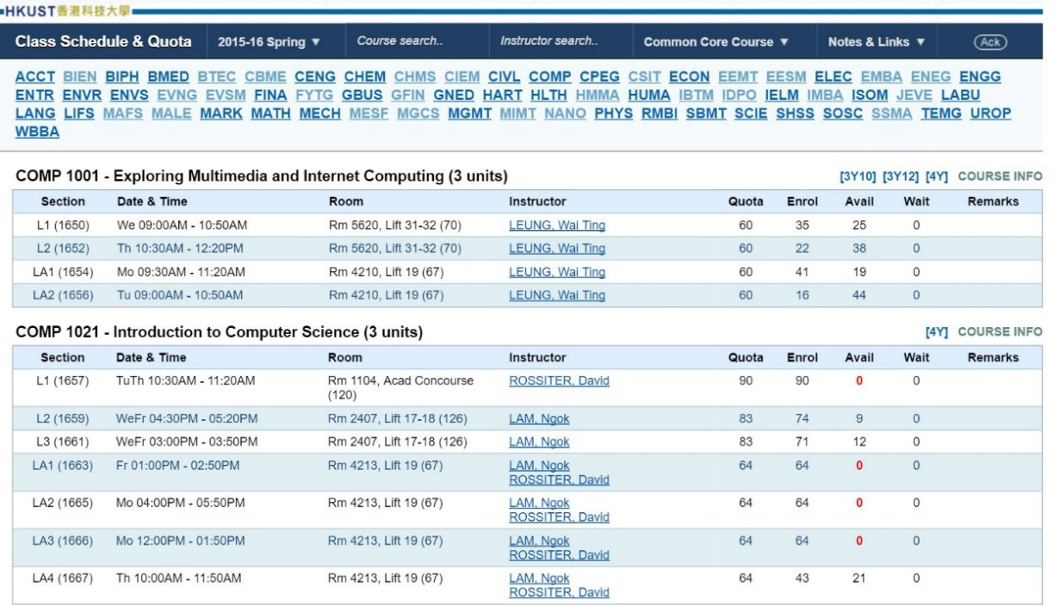
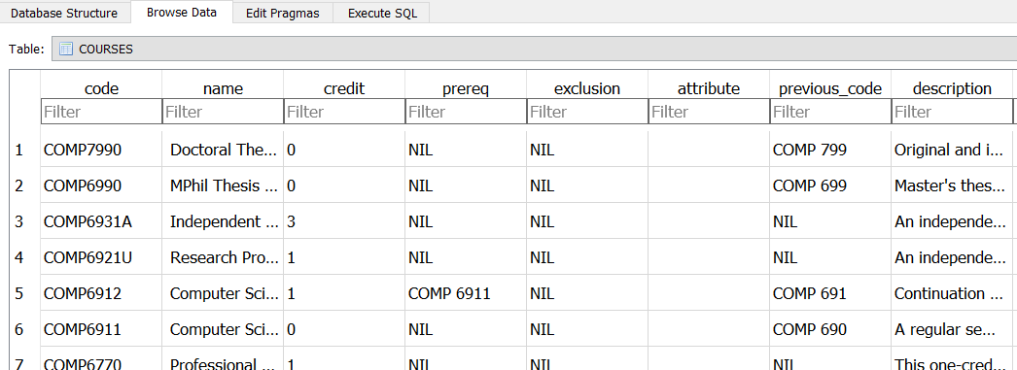
Feature – Data Grabbing
Automated Grabber Script
Obtain data from “Class Schedule & Quota”
Using DOM selector
Load data into database

Slide 5
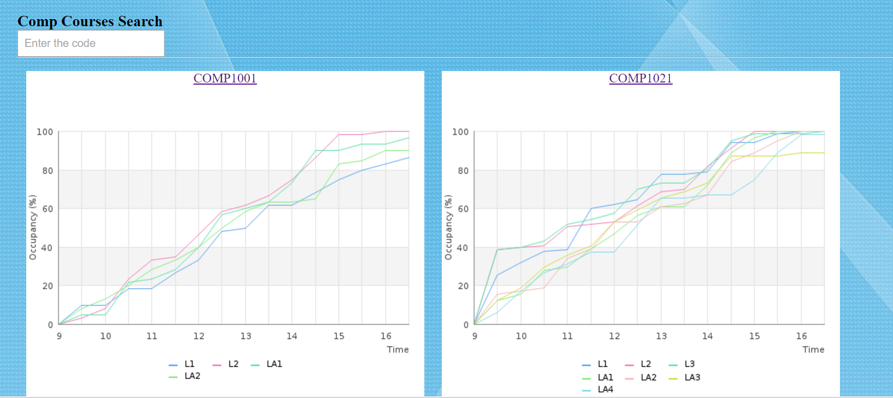
Feature – Trends
An overview of all courses
Provide filtering function

Slide 6
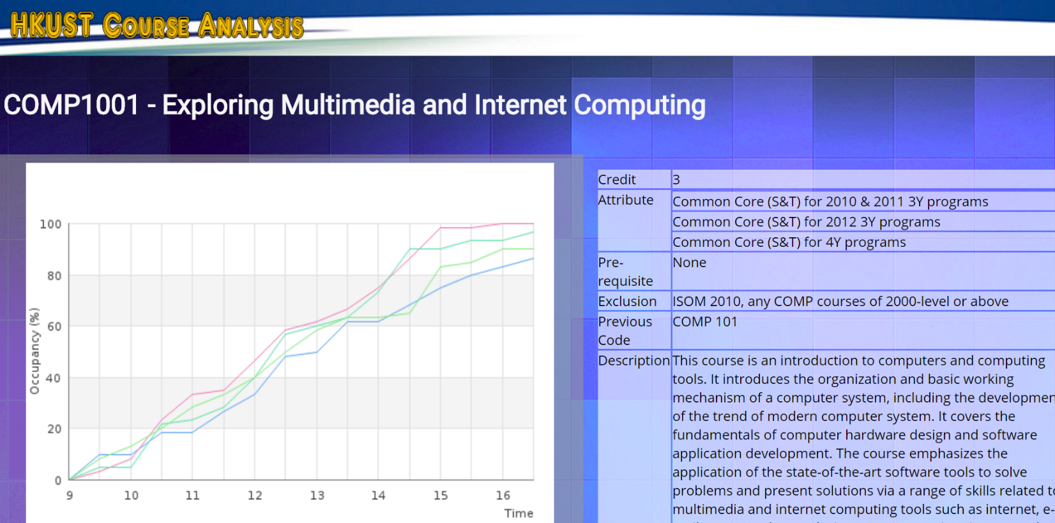
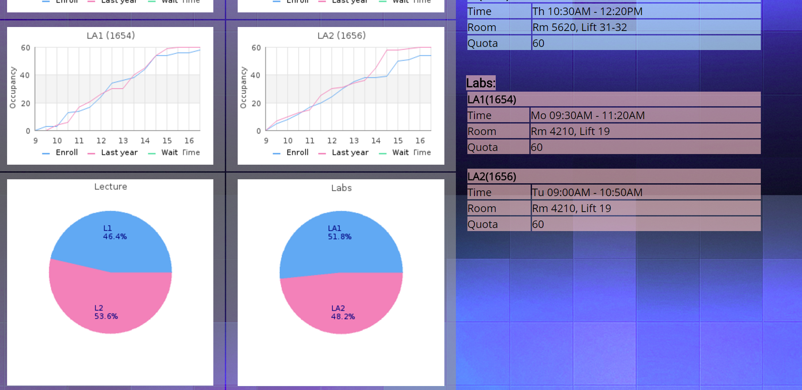
Feature – Plotting Graphs
Generate graphs from obtained data
Combine different sets of data for most intuitive result

Slide 7

Challenges and Solutions
Data grabbing
regex
Too much cases to handle
Low efficiency
DOM library and FirePath
Well-made for html parsing
Easy and direct

Slide 8

Challenges and Solutions
Data Storage
MySQL? PostgreSQL?
Overkill!
SQLite
Rarely used in server side
We don’t do concurrent writing so its ok
Fast and Light!

Slide 9
Thank you! Have Luck in Course Enrollment

